Slide 1



Workshop IoT – Internet of Things
DotNetLiguria presso l'Ordine degli Ingegneri di Genova

Slide 2
Windows 10 for IoT
Device for desktop developers

Slide 3
Grazie!
Un sentito

Slide 4
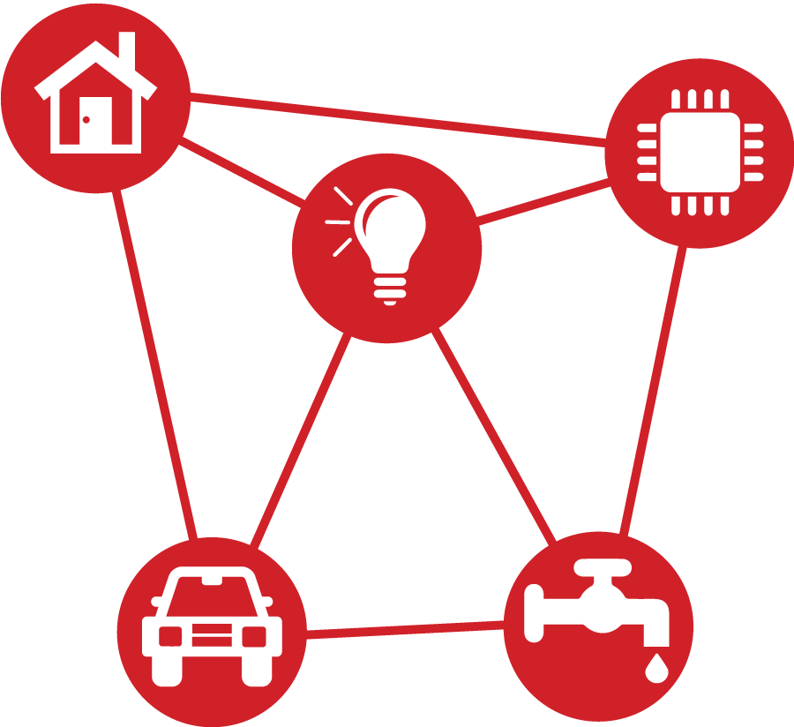
Middle-earth
?
Cloud

Slide 5
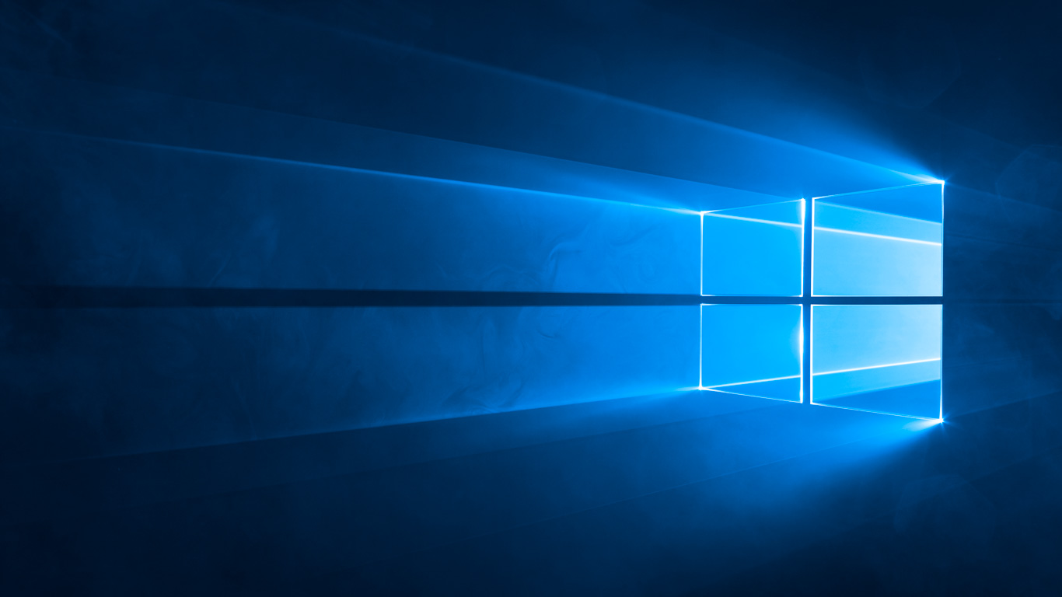
Windows 10

Slide 6
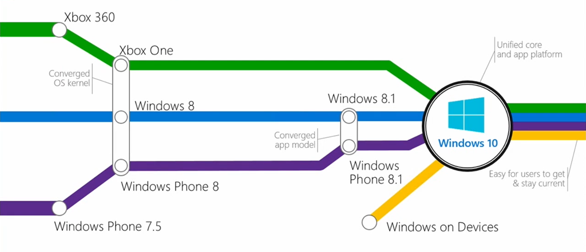
The convergence

Slide 7
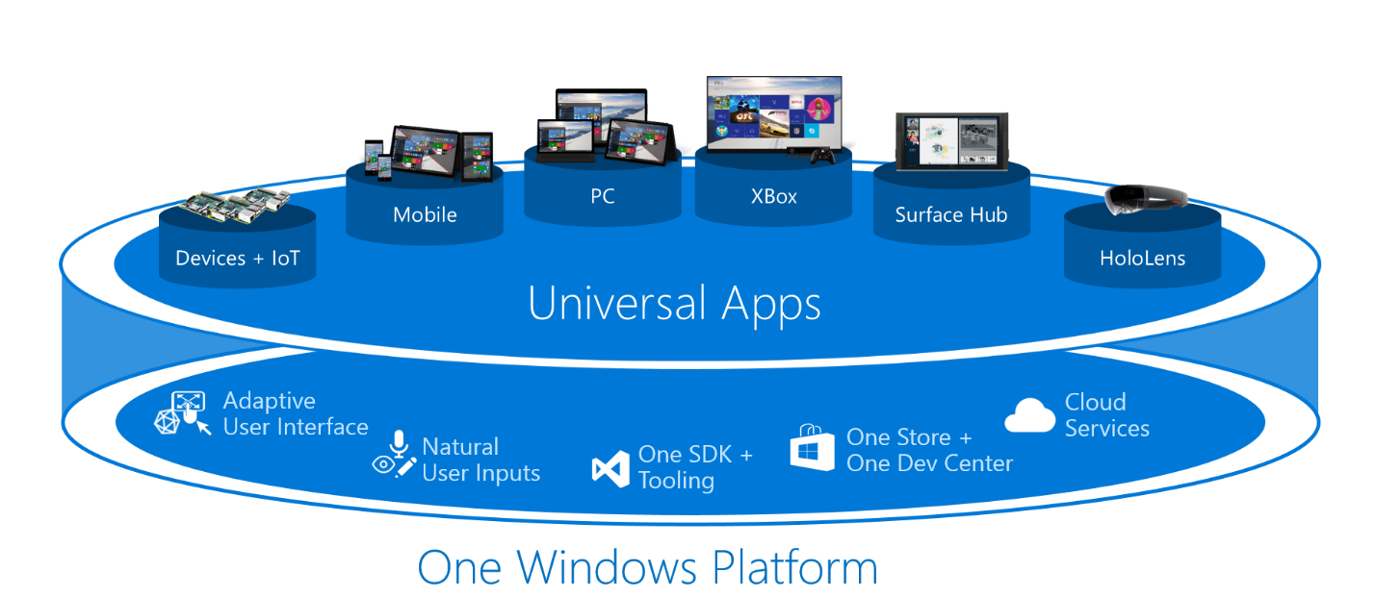
Windows 10

Slide 8
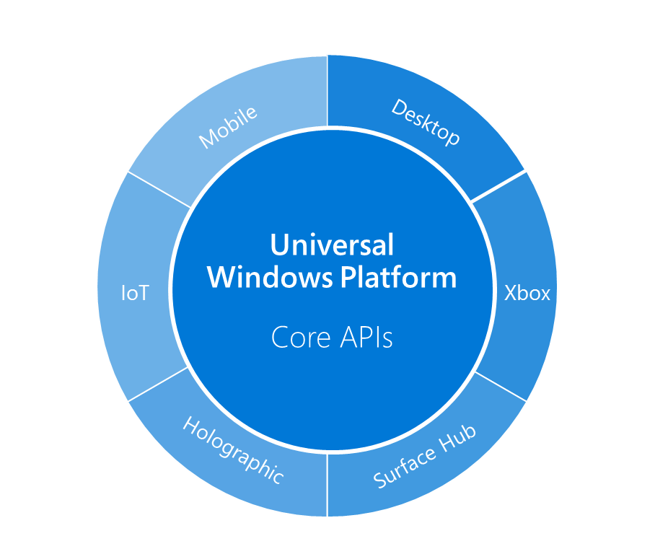
Device families extensions

Slide 9
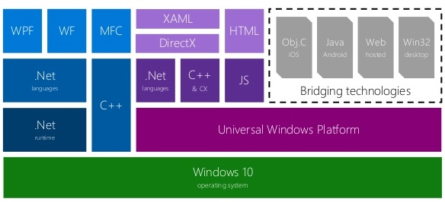
One SDK, Many Technologies

Slide 10
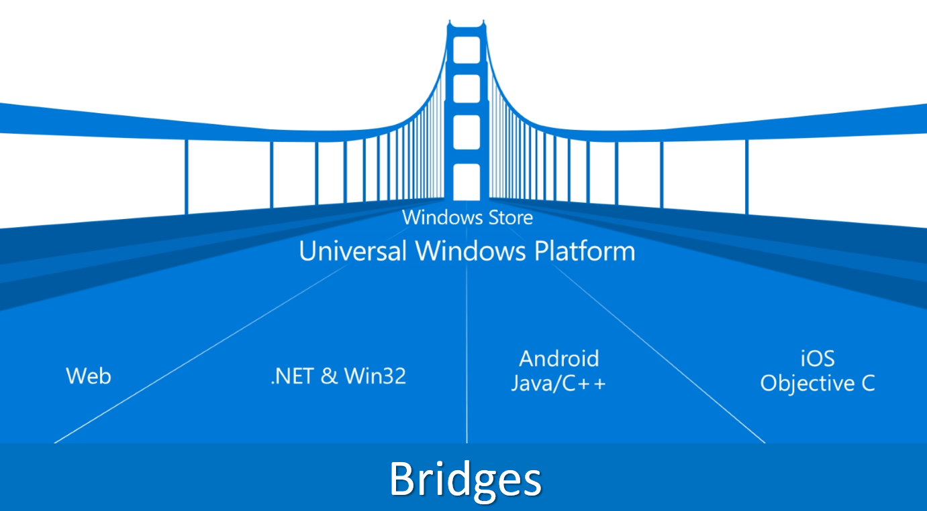
Move to Windows 10

Slide 11
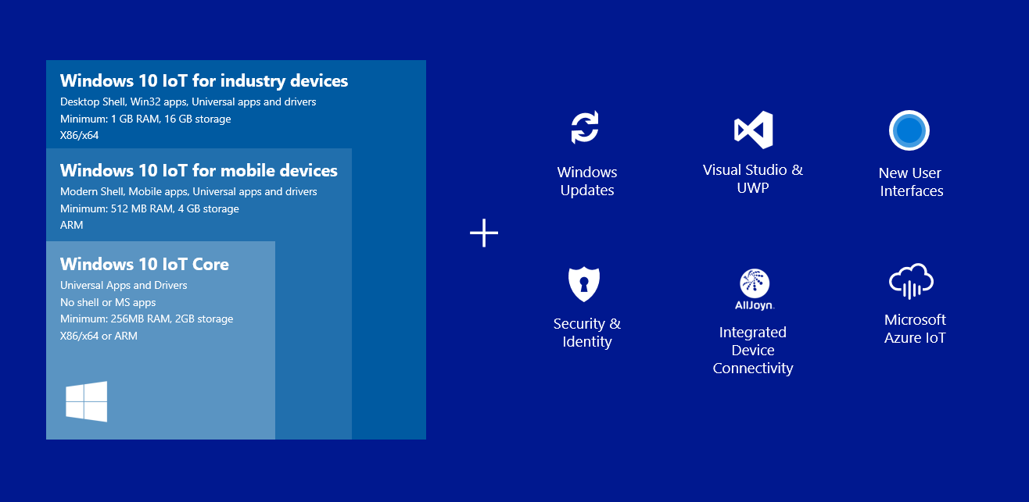
Windows 10 IoT Editions

Slide 12
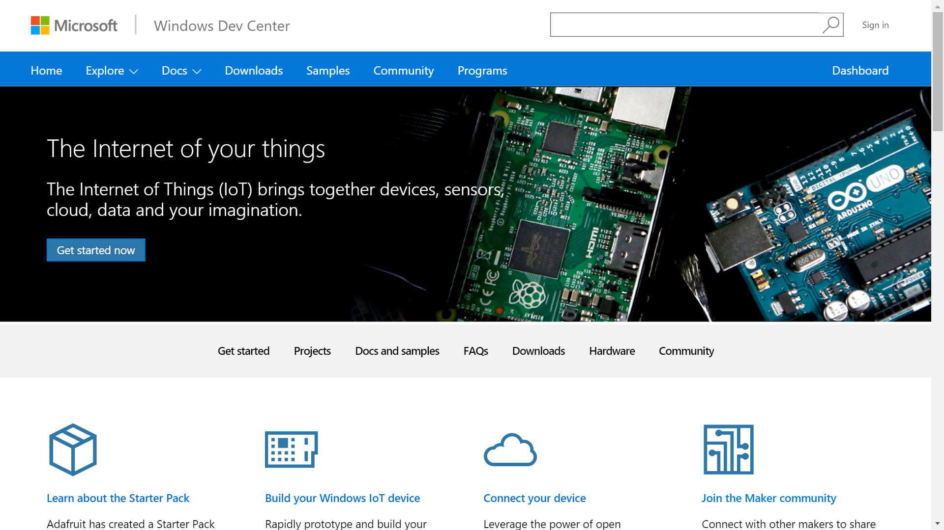
dev.windows.com/iot

Slide 13
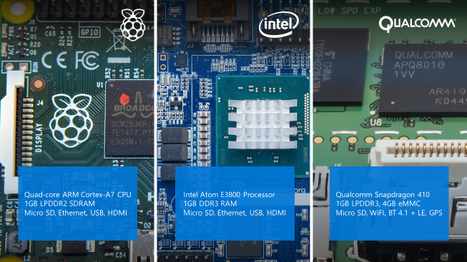
Windows 10 devices
Coming
Soon

Slide 14
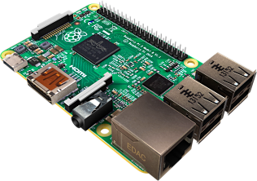
Raspberry Pi 2 B+
ARM Cortex-A7 CPU 900MHz quad-core
1GB RAM
4 USB ports
40 GPIO pins (17 generics)
Full HDMI port
10/100 Ethernet port
3.5mm audio jack and composite video
Camera interface (CSI)
Display interface (DSI)
Micro SD card slot
VideoCore IV 3D graphics core
No Wifi / Bluetooth

Slide 15
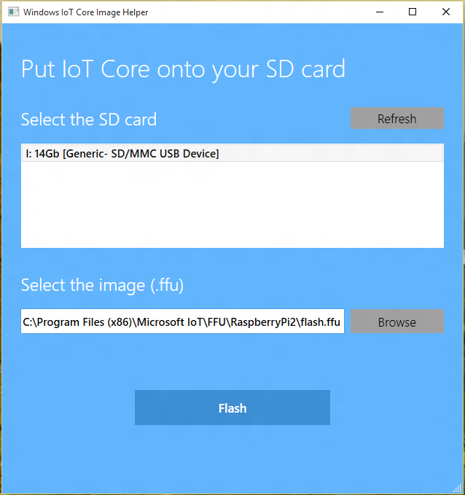
What you need
Raspberry Pi 2
5V Micro USB power supply - min 1.0A, recommended >2.0A.
8GB micro SD card - class 10 or better
Download a Windows 10 IoT Core image
PC running Windows 10

Slide 16
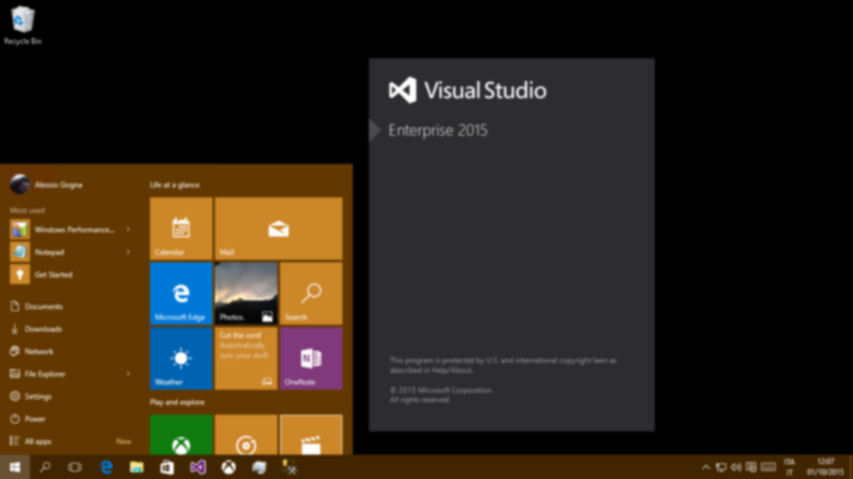
Set up your PC
Windows 10 (version 10.0.10240) or better
Visual Studio 2015
  UWA Development Tools
    Tools and Windows SDK
Windows IoT Core Project Templates
Enable developer mode

Slide 17
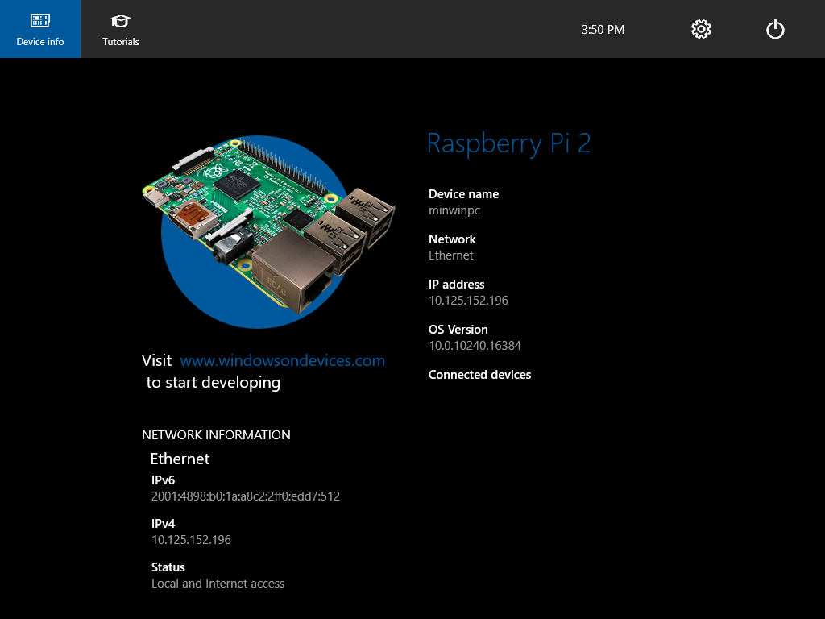
Ready…

Slide 18
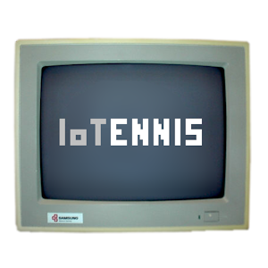
Legacy Web App

Slide 19


IoTennis
Results
Inputs
Processing

Slide 20
GO!
Demo

Slide 21
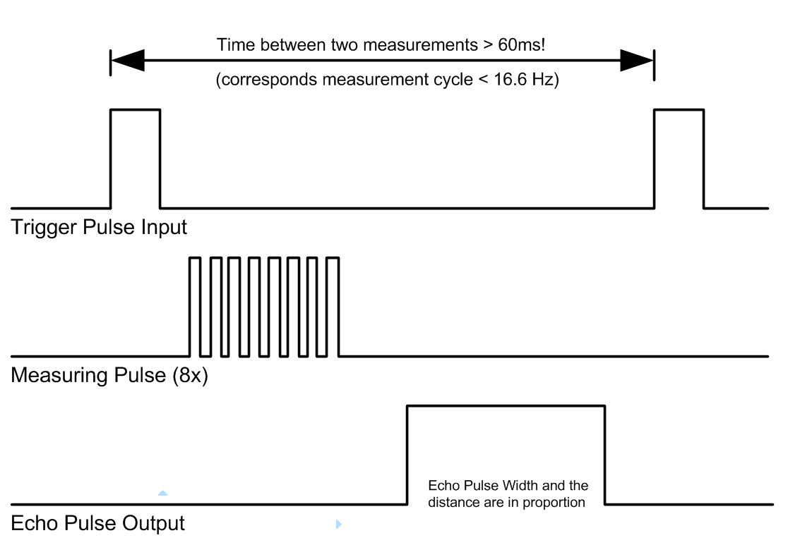
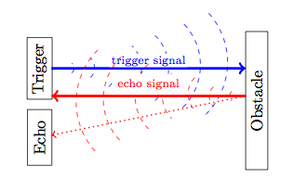
HC-SR04

Slide 22
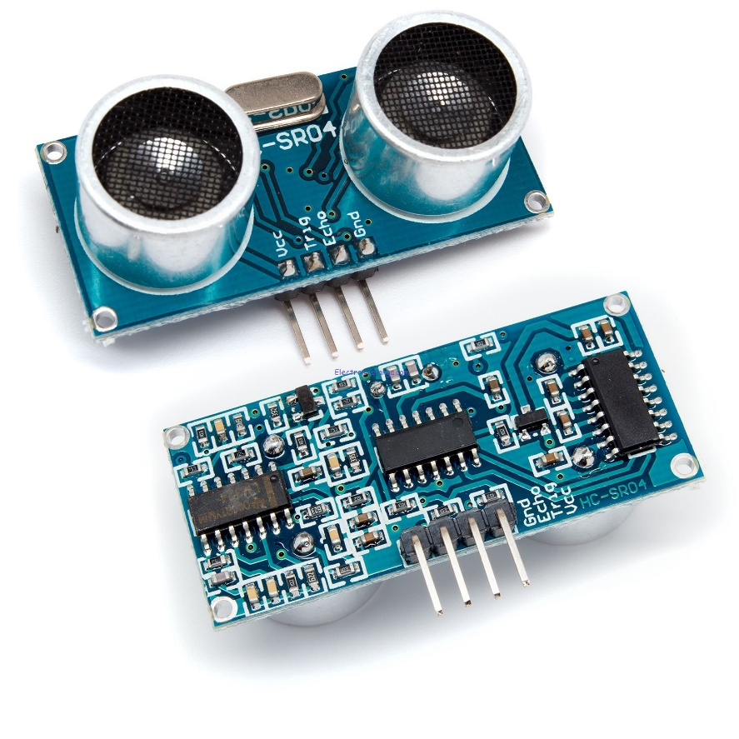
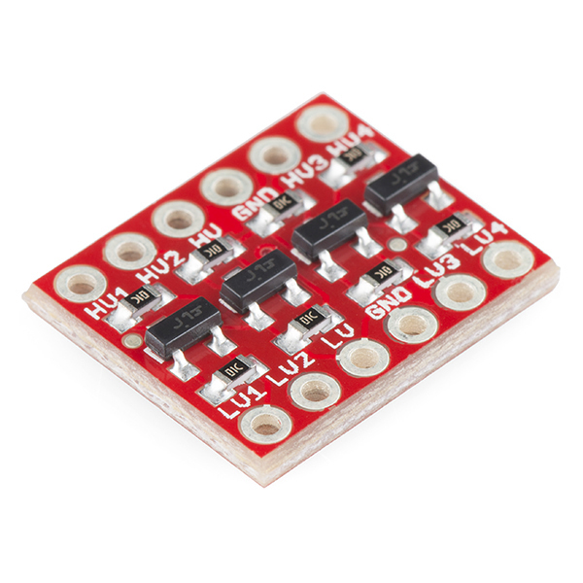
Components
Ultrasonic Ranging Module
Logic Level Converter

Slide 23
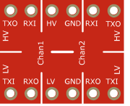
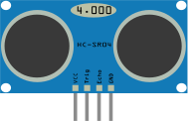
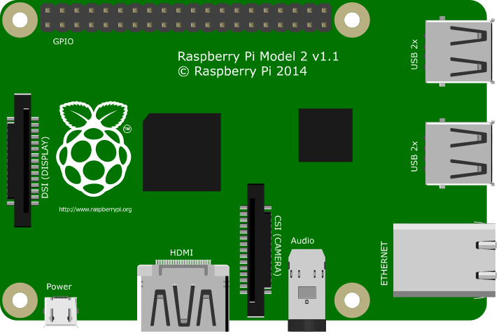
Wires
3.3V
5V

Slide 24
GO!
Demo

Slide 25
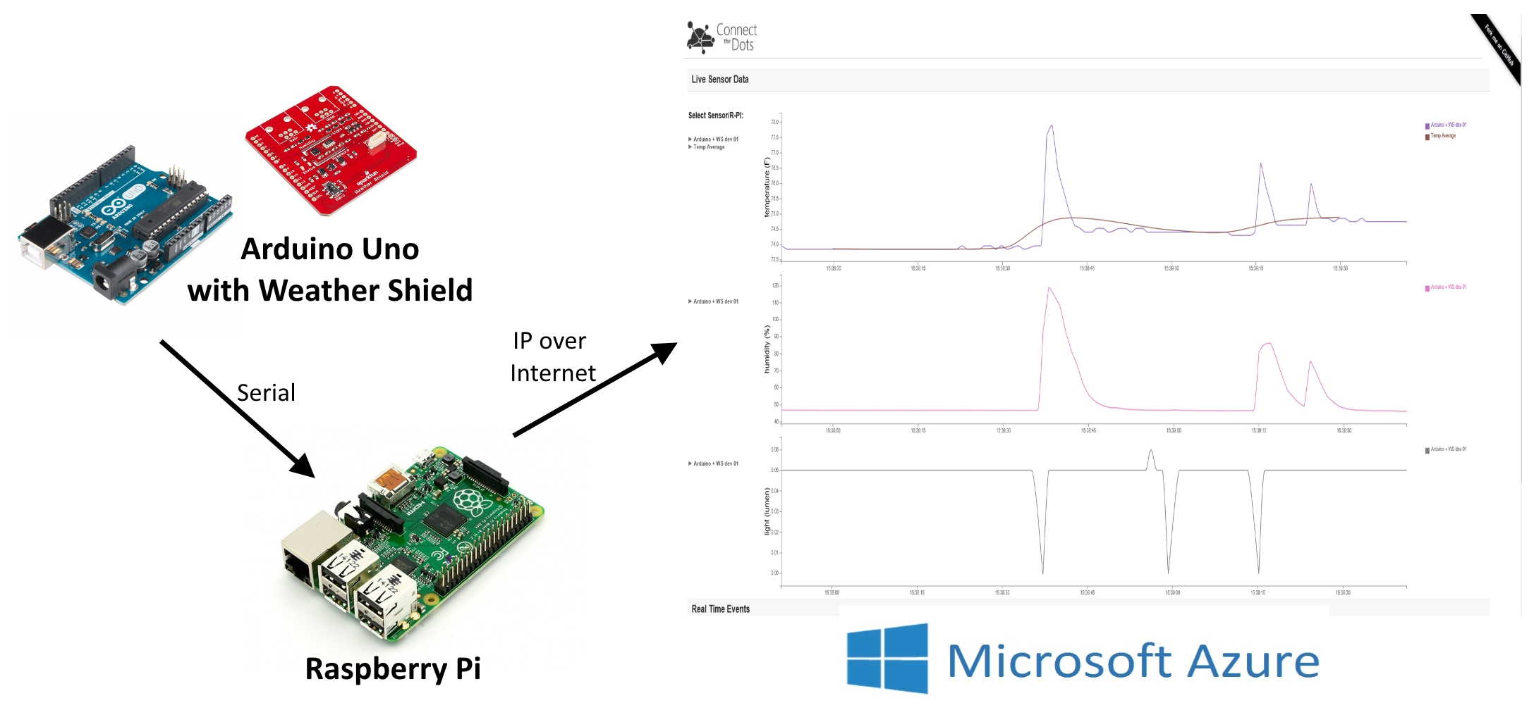
ConnectTheDots.io

Slide 26
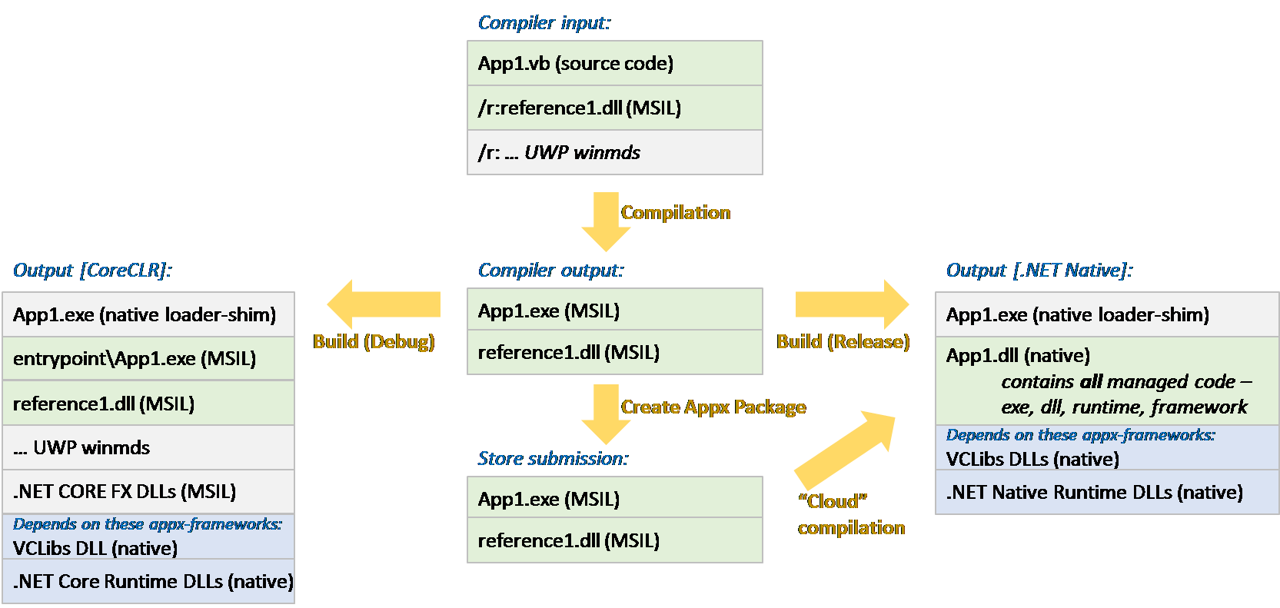
UWA with .NET

